Slide 1
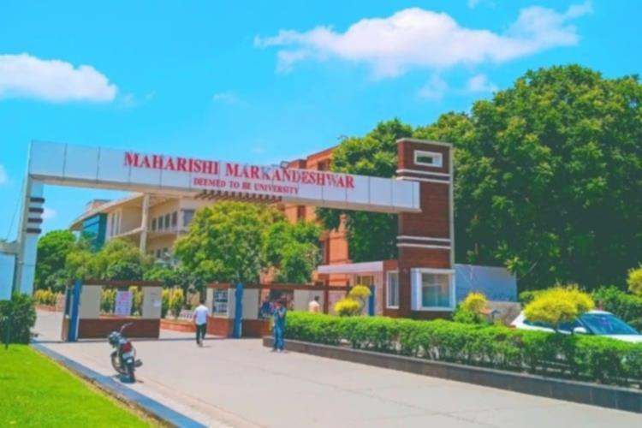




STUDENT e-Service
Project Presentation
Submitted By:
PRATIPAL KUMAR SINGH
Roll No.- 1323607
Sec-H, G2
Submitted To:
Dr. Rubika Walia
Designation : Assistant Professor
College : MMICT&BM

Slide 2

Introduction

Slide 5
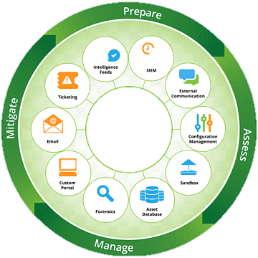
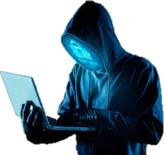
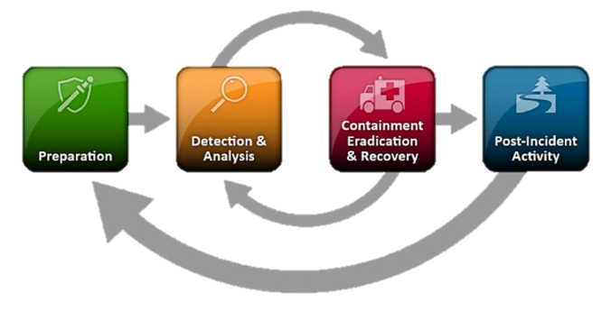
Field of Cyber Security
Security Analyst
Incident Responder
Penetration Tester(Ethical Hacker)
Security Engineer/ Cryptographer
Security Awareness Trainer
Virus & Malware
Security Researcher (ISRAG)
Security Consultant
Hackers
Trojan Attacks
Password Cracking

Slide 6

How to Join IB/CS/R&AW
K. Subramanyam – “No First Use” Policy of Nuclear Weapon.
Join R&AW/IB/CyberSecurity :
Through : UPSC CSE, : IFS, IPS, IAS
Through : Indian Army : SPG than IB.
Security provided by Ethical is called cyber security only include network system connection.
Learn CEH : Certified Ethical Hacker.
CHFI: Certified Hacking Forensic Investigator.
EJPT: eLearnSecurity Junior Penetration Tester.
OR, Learn degree in relative field as IT, and Join Hackathon

Slide 7
Benefits & Losses in Cyber Security
# Honey Trap : Anti-terrorism Squad (ATS) has a female intelligence arrest DRDO Chief theft some information by honey trap his arrest in Pune. With Pakistani based intelligence.
By DDoS Attacks overload Airports, Government Ministry Portal etc.
February 2021, including HDFC, SBI, ICICI and Axis Bank faced DDoS Attacks.
USB Drop Attacks –
First Virus is “Creeper Virus” developed by Bob Thomas at BBN as experimental, self-duplication program. “Purpose Security Test”
The Mydoom virus was the dangerous than ILOVEYOU virus.
His Create One in Four Mail sent globally, Most destructive virus in history . (No body knew his developer )

Slide 8
Law of Cyber in IT.
IT Act 2013, “need to change it because technologies are more developed by not changes any act under the IT.
Cyber Offences under Penal Code 1860.
Acts Offence Under IPC IPC
Sending threatening massage – Criminal Intimidation – Section 503
Sending defamatory massage – Defamation - Section 499
Bogus websites, Cyber Fraud – Cheating - Section 420
Web jacking - Extortion - Section 383
Spoofing/Forged e-records – Forgery - Section 463
Pornography – Obscenity - Section 292
Online Harassment – Stalking - Section 352-D

Slide 9

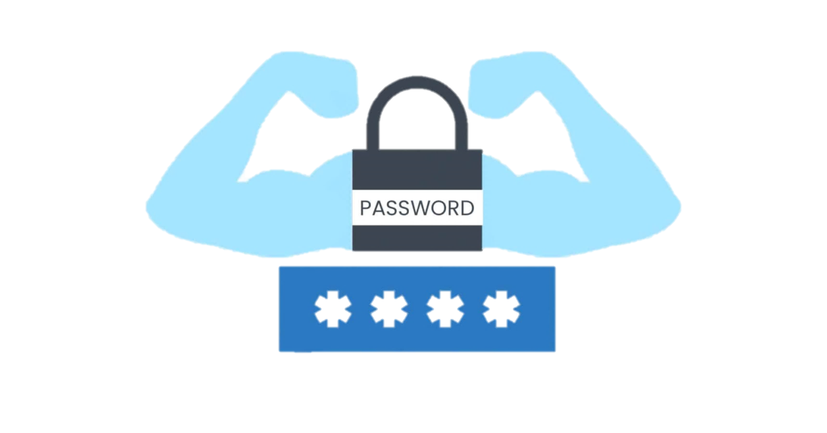
Importance of Cyber Security Awareness
The reason of Security awareness is important because it’s the how to save our personal information.
Phishing Prevention Knowledge
Strong Password Security
Malware Defense
Data Protection
Device Security
Safe Online Practices/Financial
Social Engineering Awareness
Public Wi-Fi Awareness
Overall Cyber Resilience

Slide 10
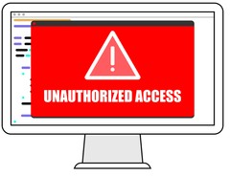


Weakness of Privacy & Security
Illegal System Access
Illegal Interception
System Interference
Data Interference
Misuse of Device
Fraud
Limited Resources
Old IT Act. 2013 overall 10 year
Constantly Evolving Threats
Legal and Compliance issues.
Human Awareness Factor, Sensitive Information

Slide 11
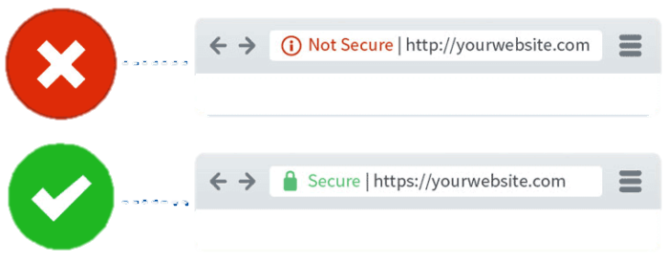


How to Save you to Cyber attacks & Safety tips
Use antivirus software.
Insert Firewalls, POP UP blocker.
Uninstall unnecessary software.
Maintain system backup.
Check security setting.
Use secure connection
(Ex. Always prefer Personal Wi-Fi, or https://)
Open attachment carefully.
Don’t Click Unknown Links and mail attachment file etc.
Use strong password and (not save on email).
Don’t give personal information unless required.

Slide 12
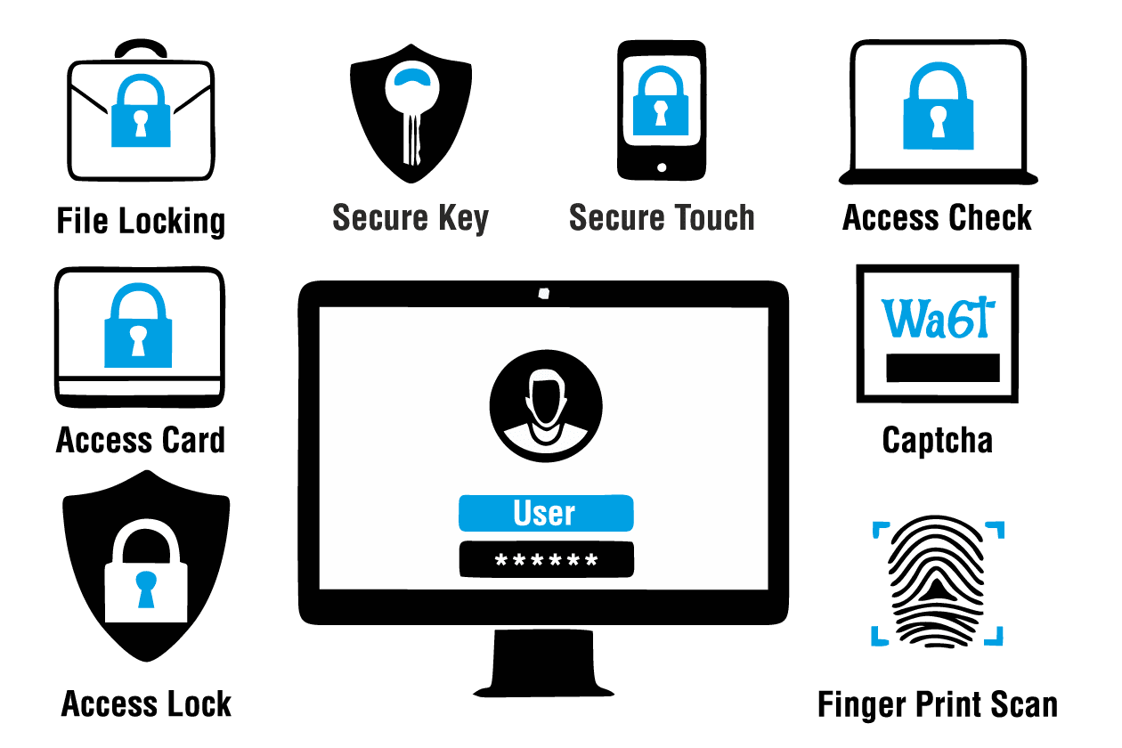

Advantages of Cyber Security.
Protect data and Information
Prevention from unauthorized access
Control web portal
Safeguard from viruses
Safe & Secure
Safe with Fraud
Cyber Crime Safety
Protect personal information
Save govt. information
Protect Nuclear Weapon, Controls
Save by Threats & Hacker Attacks

Slide 13
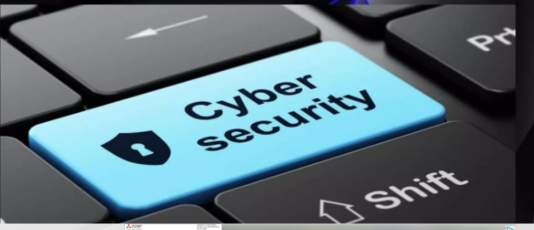
Cyber Crime?
Cybercrime refers to criminal activities conducted through the use of digital technologies, networks, or devices. It encompasses a wide range of illegal actions that exploit vulnerabilities in computer systems, target individuals, organizations, or governments, and often involve the theft, manipulation, or destruction of data.
Examples include hacking, phishing, ransom ware attacks, identity theft, and various forms of online fraud. Cybercrime poses significant threats to cyber security and can result in financial losses, data breaches, and disruption of services.

Slide 14


Types of Cyber Crime.
Hacking & Phishing
Cracking & Identity Theft
Cyber Stalking
Email-Spoofing
SMS Spoofing
Online Scams, Cheating & Fraud
Cyber bullying Child Pornography
Transmitting Virus etc.
Malware & DDoS Attacks.
Data Breaches
Anonymous Unauthorized Access.
hYounger Cyber Crime Investigate Officer
@Dipanshu Parashar

Slide 15
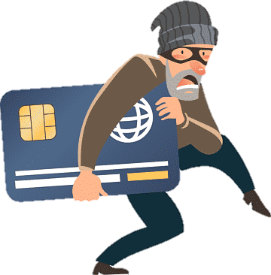
Why need Cyber Security Knowledge.
Necessary Cyber Security Knowledge :
Protect Against Cyber Treats
Safeguarding Personal Information
Securing Financial Assets
Preserving Privacy
Preventing Business Disruption
National Security & Data Breach
Maintaining Reputation
Compliance and Legal Obligations
Adaptation of Technological Changes
Promoting Innovation

Slide 16
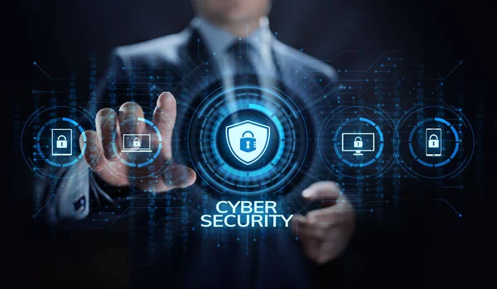

What is the purpose of Cyber Crime portal?
This portal is an initiative of Government of India to facilitate victims/complainants to report cyber crime complaints online. At present this portal caters to complaints pertaining to online Child Pornography (CP)-Child Sexual Abuse Material (CSAM) or sexually explicit content such as Rape/Gang Rape (CP/RGR) content. The portal also provides an option of reporting an anonymous complaint, where complainants are not required to disclose their identity.

Slide 17
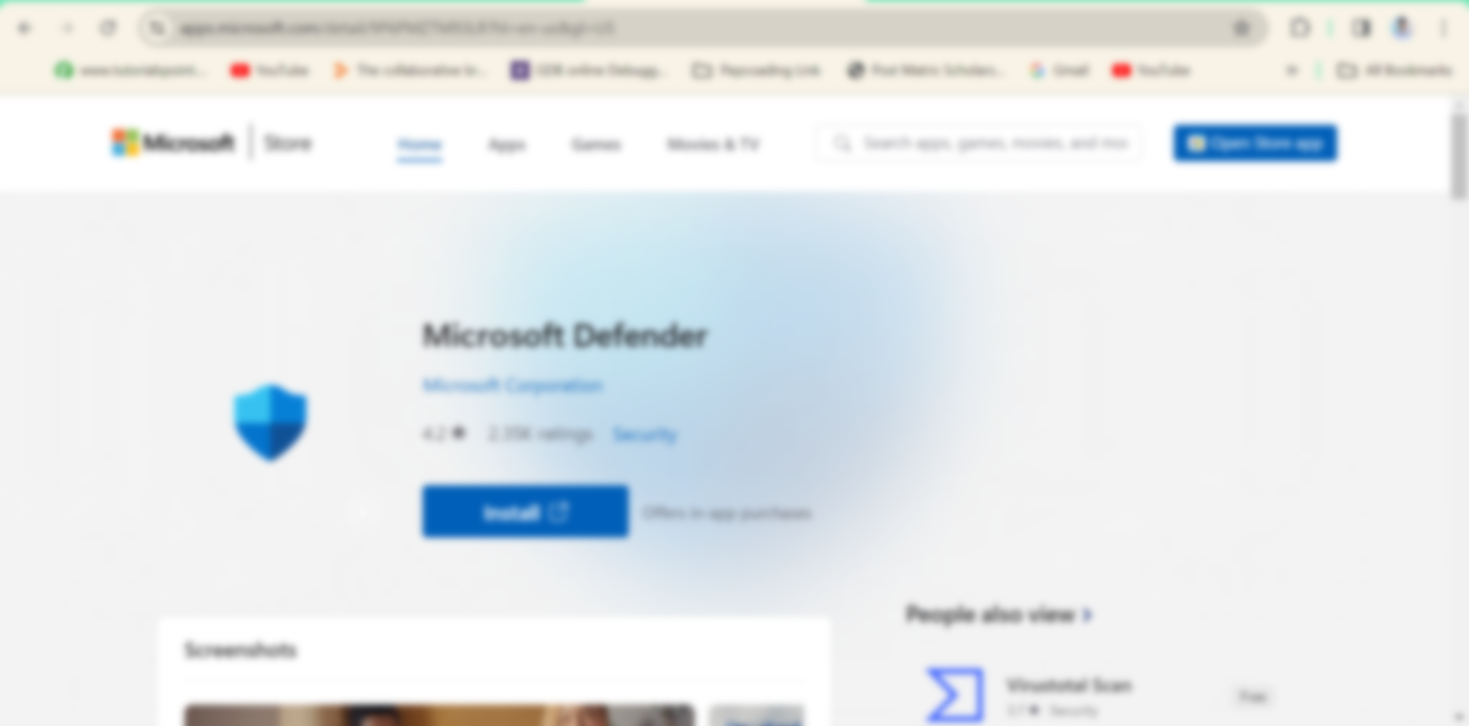
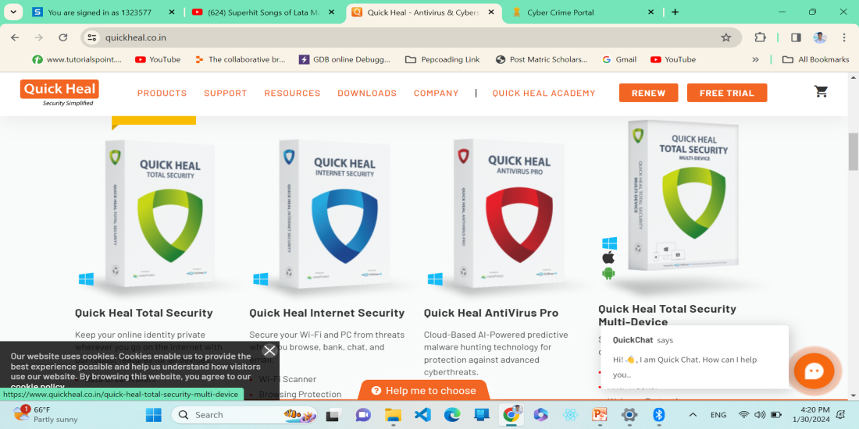
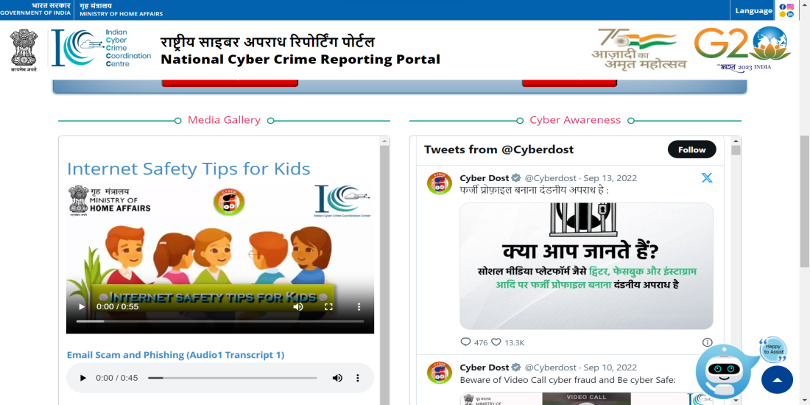
https://cybercrime.gov.in/
Computer Course : ADCA – Learn about Security
https://apps.microsoft.com/detail/windowsdefinfer
Support & Resources.

Slide 18


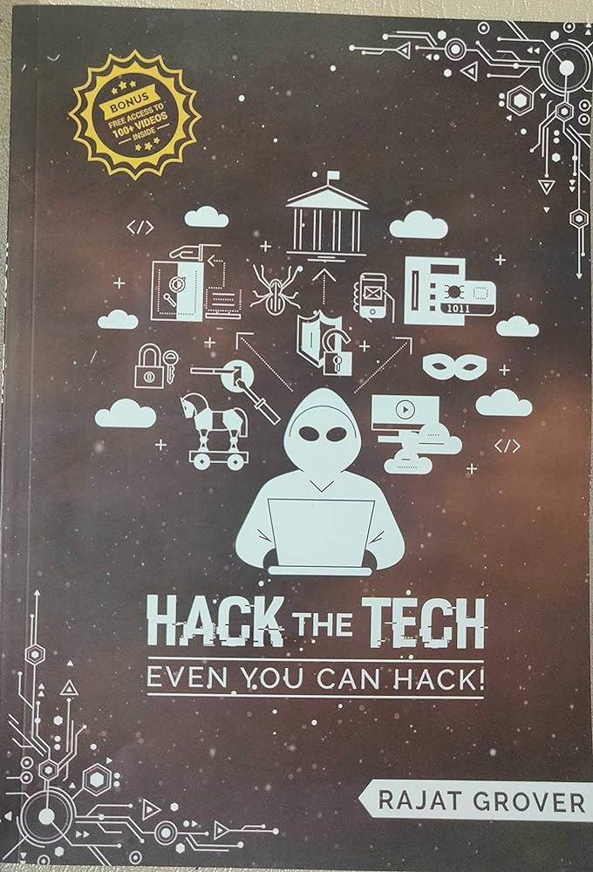


References
Learn in www.hackthetech.org/@pratipalmaurya
Learn in https://en.wikipedia.org/wiki/B._Raman
Learn from https://en.wikipedia.org/wiki/R.N.Kao
Learn in https://cert.eccouncil.org/certified-ethical-hacker.html
Learn in https://en.wikipedia.org/wiki/Computer_security
Learn in https://en.wikipedia.org/wiki/Cybercrime
Learn in https://en.wikipedia.org/wiki/Research_and_Analysis_Wing

Slide 19

Thank You
Seminar - I
Presentation Slides By:
Pratipal Kumar Singh
Roll No.- 1323607 Sec-H, G2

